Slide 1
Deploying Nano Server with Lability
A proof-of-concept
https://github.com/VirtualEngine/Lability/tree/dev
Iain Brighton – Virtual Engine
Notes:
Why? I needed to experiment with Nano for my own curiosity and, at the time, creating Nano server images wasn’t “easy”.
Lability has had Nano server support since 2016 TP3

Slide 2
Agenda
Hyper-Converged Clusters
What is Lability
Creating Nano Server images
Deploying infrastructure
Creating Hyper-Converged cluster

Slide 3
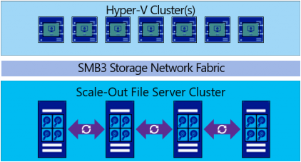
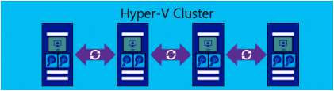
Hyper-Converged Clusters
Hyper-V Host
Notes:
Disaggregated cluster

Slide 4
What is Lability
Hyper-V Lab deployment framework
Leverages existing DSC configuration documents
Adds Lability metadata
Open-source equivalents
Packer - Image creation
Vagrant - Image provisioning
Experimental support for:
Adding additional VM hard disks
Setting VM processor options
Notes:
PluralSight’s AutoLab - https://github.com/theJasonHelmick/PS-AutoLab-Env

Slide 5
Nano Server Images
Standard WIM image
Lability images
Bootstrapping
Packages
Hotfixes
Custom images
Notes:
Get-LabMedia | Where Id -match Nano
ls D:\Lability\ParentDisks\

Slide 6
Demo
Creating Nano Server Images/VMs

Slide 7
Cluster Deployment
Create VMs
Domain Controller
Nano Servers (x3)
Nested virtualisation
VHDXs for S2D
Wait for DSC completion
Active Directory deployment
Create failover cluster
Enable Storage Spaces Direct (S2D)
Notes:
PR requests out for xVMHost and xVMProcessor resources

Slide 8
Demo
Compiling configuration and deploying VMs

Slide 9
Clustering on Nano Server
You cannot run failover clustering cmdlets on a local Nano Server through Windows PowerShell.
Clusters must be managed remotely with Failover Cluster Manager or Windows PowerShell.
Notes:
https://docs.microsoft.com/en-us/windows-server/get-started/deploy-nano-server

Slide 10
New NanoCluster Resource
“Quick n’ dirty” composite resource
Requires PowerShell v5
github.com/iainbrighton/NanoCluster
Supports “remote” cluster deployment
NanoCluster
NanoClusterS2D
NanoClusterS2DVolume
WaitForNanoCluster
Notes:
https://docs.microsoft.com/en-us/windows-server/get-started/deploy-nano-server

Slide 11
Demo
Deploying Hyper-Converged Cluster

Slide 12
Gotchas
Storage Spaces Direct min 4 disks
E.g. 4 nodes with 1 disk
“Waiting for disks to surface”
Install the latest cumulative updates!
Cluster creation timing/DNS issues
Use WaitForNanoCluster resource
MAC address spoofing?
Notes:
https://docs.microsoft.com/en-us/windows-server/storage/storage-spaces/storage-spaces-direct-hardware-requirements
https://docs.microsoft.com/en-us/windows-server/storage/storage-spaces/choosing-drives

Slide 13
Summary
Lability can create Nano server images
Images can also be used outside of Lability
Create custom Lability Nano Server media entry per package bundle
xHyper-V DSC module now* contains xVMHost and xVMProcessor resources
xVMHardDiskDrive is coming..

Slide 14
Next Steps...
Now: 15 min break
Grab a coffee
Stay here to enjoy next presentation
Change track and switch to another room
Ask me questions or meet me in a breakout session room afterwards

Slide 15
Questions?

Slide 16
About_Author
Principal Consultant @ Virtual Engine
Automation and end-user computing focused consultancy company
RES Consulting Partner, RES Certified Trainer (RCT) and Valued Professional (RSVP)
Amateur developer
PScribo – a PowerShell documentation DSL
Community DSC resource contributor
Citrix XenDesktop 7.x and NetScaler

